Slide 1

HAM 27 FINAL PROJECT
ED COLEMAN

Slide 2

HAM 27 INTRO
Represents all 27 items from the Hamilton Depression Scale
Another var that only contains the first 17 items is also in the data; this variable is more commonly used when discussing the Hamilton Depression Scale
Value comes from questionnaire used to indicate signs of depression and guide patients to recovery
The HRSD (Hamilton Rating Scale for Depression) is controversial due to its focus on insomnia rather than self-destructive thoughts or feelings (only 17% of the patients were categorized with Severe Depression)
We would of course assume that depression would be a vital symptom of cocaine withdrawal, so this is certainly important to look at for this study

Slide 3
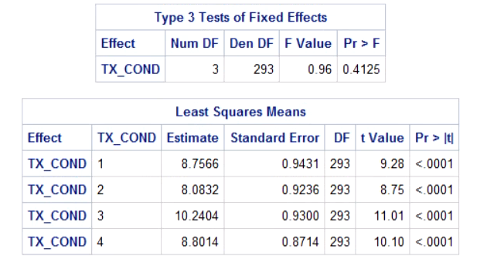

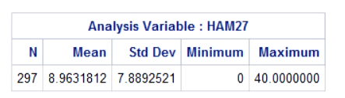
CROSS SECTIONAL ANALYSIS AT MONTH 3
Creating Month 3 Data Set:

Slide 4
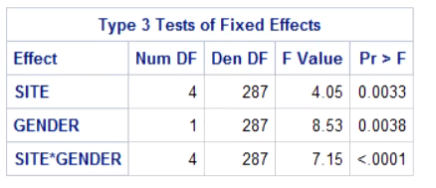
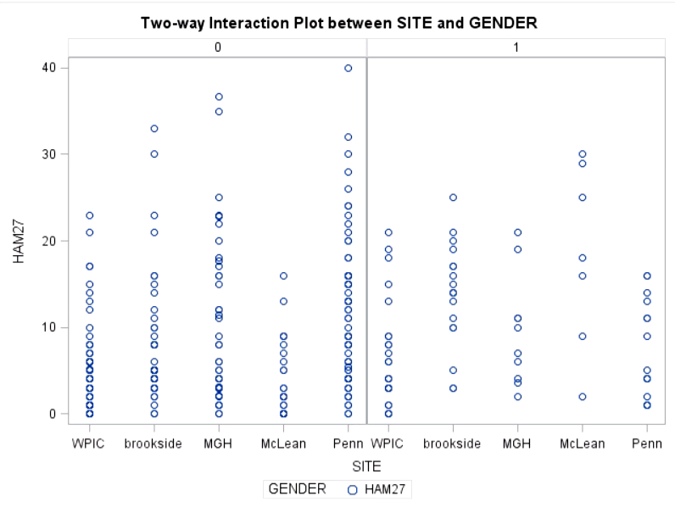
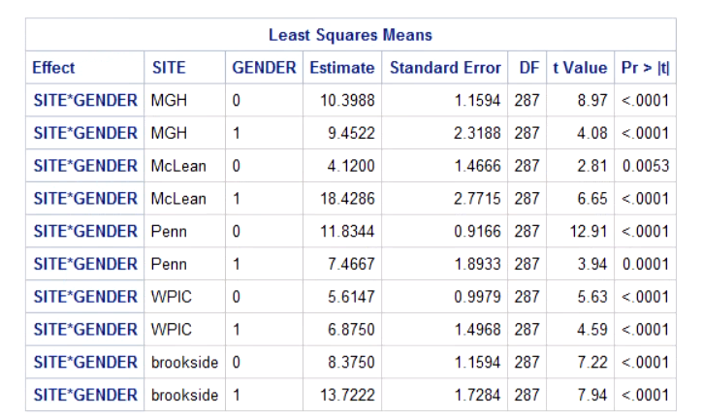
TWO-WAY INTERACTION AT MONTH 3

Slide 5
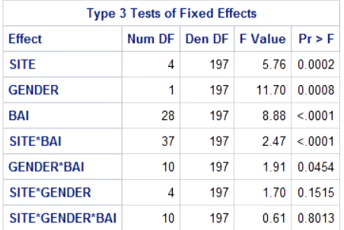
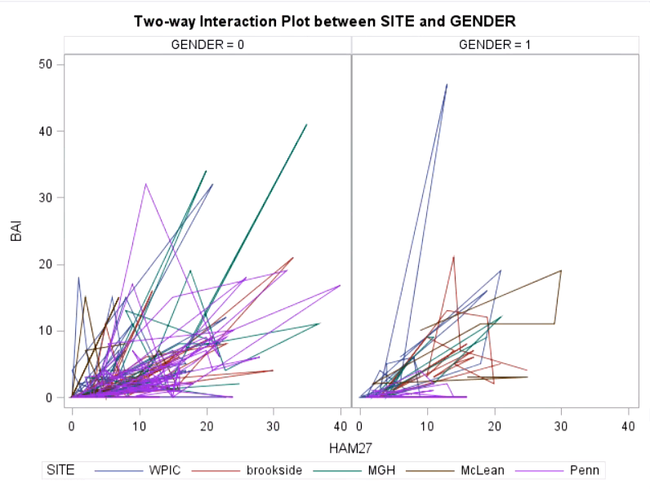
THREE WAY INTERACTION MONTH 3
OTHER VARS CONSIDERED: BAI, RACE, EDUCATE, GTHS, CRACK, JOB, MAR_STAT, etc.

Slide 6
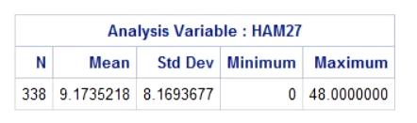
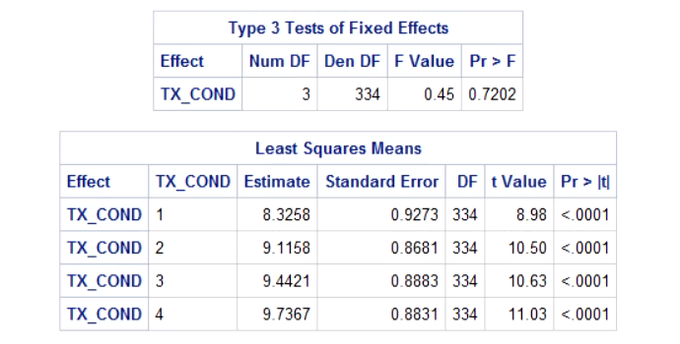
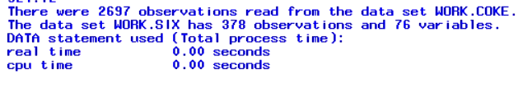
CROSS SECTIONAL ANALYSIS AT MONTH 6
Creating Month 6 Dataset:

Slide 7
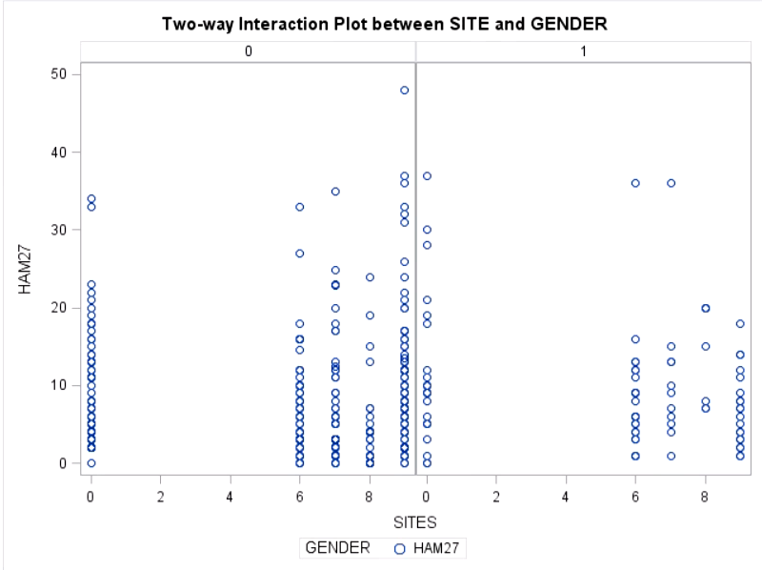
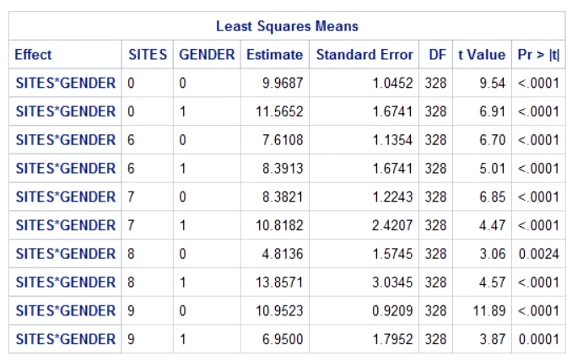
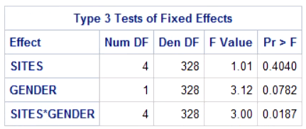
TWO WAY INTERACTION AT MONTH 6

Slide 8
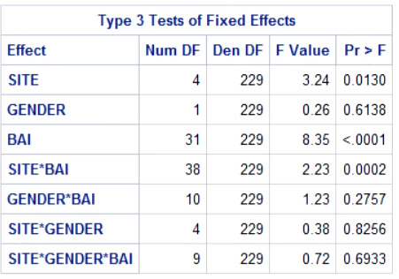
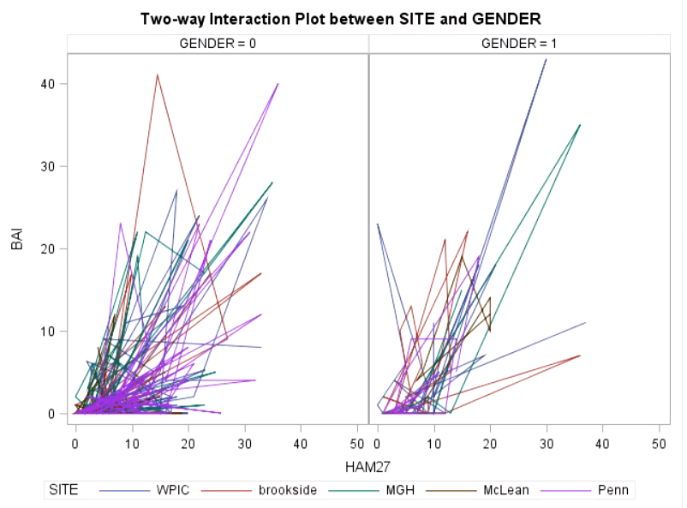
THREE WAY INTERACTION AT MONTH 6
OTHER VARS CONSIDERED: BAI, RACE, EDUCATE, GTHS, CRACK, JOB, MAR_STAT, etc.

Slide 9
RESULTS & CONCLUSIONS TWO WAY INTERACTIONS
MONTH 3
MONTH 6

Slide 10
RESULTS & CONCLUSIONS THREE WAY INTERACTIONS
MONTH 3
MONTH 6

Slide 11


THANKS FOR LISTENING!
This Photo by Unknown author is licensed under CC BY.

